Slide 1
TREE ADT
Group 3

Slide 2
What is a Tree ADT?
A tree is a (possibly non-linear) data structure made up of nodes or vertices and edges without having any cycle.
Is a fundamental data structure in computer science used to represent hierarchical relationships.
The tree with no nodes is called the null or empty tree.
A tree that is not empty consists of a root node and potentially many levels of additional nodes that form a hierarchy.

Slide 3
TREE ADT Operations
Traversal - refers to visiting the nodes of a tree in a systematic manner.
Inorder – visits left subtree, root, right
Preorder – visit root, left, right
Postorder – visit left subtree, right, root
Basic Operations
Insertion
Deletion
Search
Modification

Slide 4
Cont…
Traversal – Visits nodes in a specific order.
Height – Determine the Depth of a Tree
Size – Count the total number of nodes in the tree.
Minimum/Maximum – Find smallest or largest value
Successor/Predecessor – Locate the next or previous node in sorted order.
Common Ancestor – Identity the lowest common ancestor of the nodes.
Balancing – Ensure the tree remains balanced e.g AVL trees, Red-Black trees

Slide 5
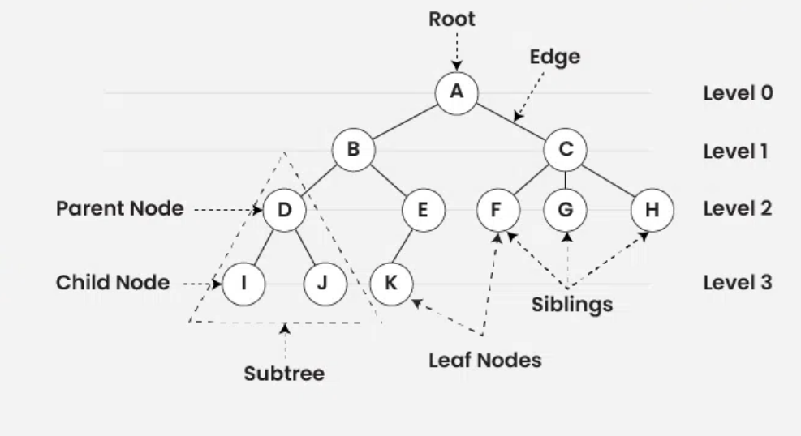
TREE ADT

Slide 6
Tree ADT Properties
Nodes - Each element in the tree is called a node. It contains a value or data and may have links to other nodes.
Edges - The connections between nodes are called edges.
Root - The top node of the tree, which has no parent. Every tree has exactly one root node.
Parent - A node that has one or more child nodes is called a parent.
Child - A node that is directly connected to another node (its parent) is called a child.
Leaf - A node that has no children. It is also referred to as a terminal node.
Internal Node - A node that has at least one child. It is not a leaf.
Subtree - consists of a node and all its descendants. Each node of a tree can be considered the root of a subtree.
Level - The level of a node is its depth plus one. The root node is at level 1.
Degree - The degree of a node is the number of children it has. The degree of a tree is the maximum degree of any node in the tree.
Path - is a sequence of nodes where each node is connected to the next by an edge.

Slide 7
Binary Tree Specific Properties
Binary Tree: Each node has at most two children, commonly referred to as the left child and right child.
Full Binary Tree: Every node other than the leaves has exactly two children.
Complete Binary Tree: All levels are fully filled except possibly for the last level, which is filled from left to right.
Perfect Binary Tree: All internal nodes have exactly two children, and all leaves are at the same level.
Balanced Binary Tree: The height difference between left and right subtrees of any node is at most one.

Slide 8
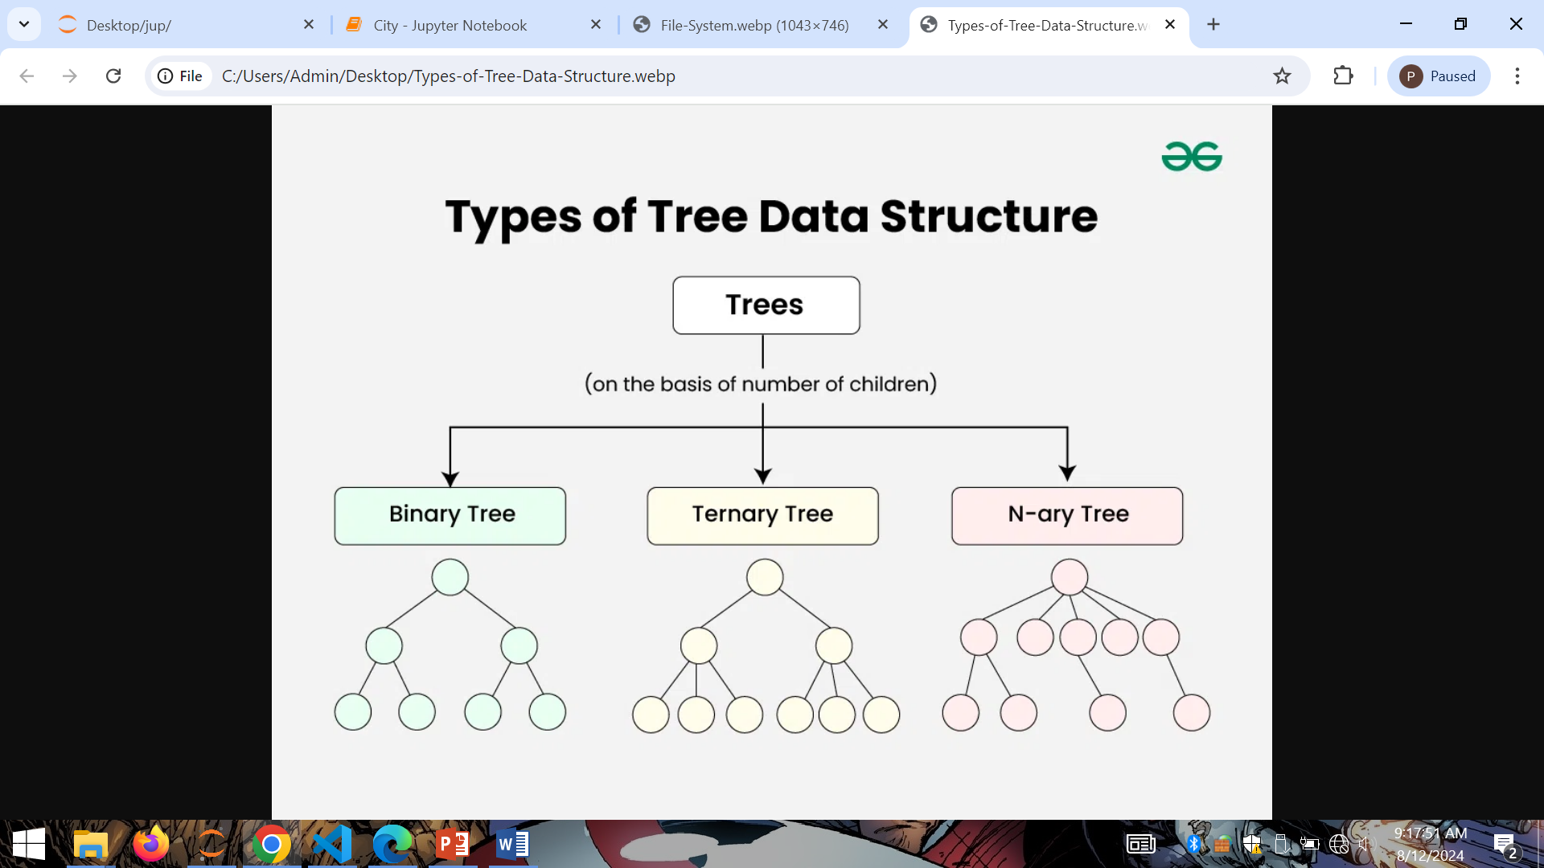
TYPES OF TREE

Slide 9
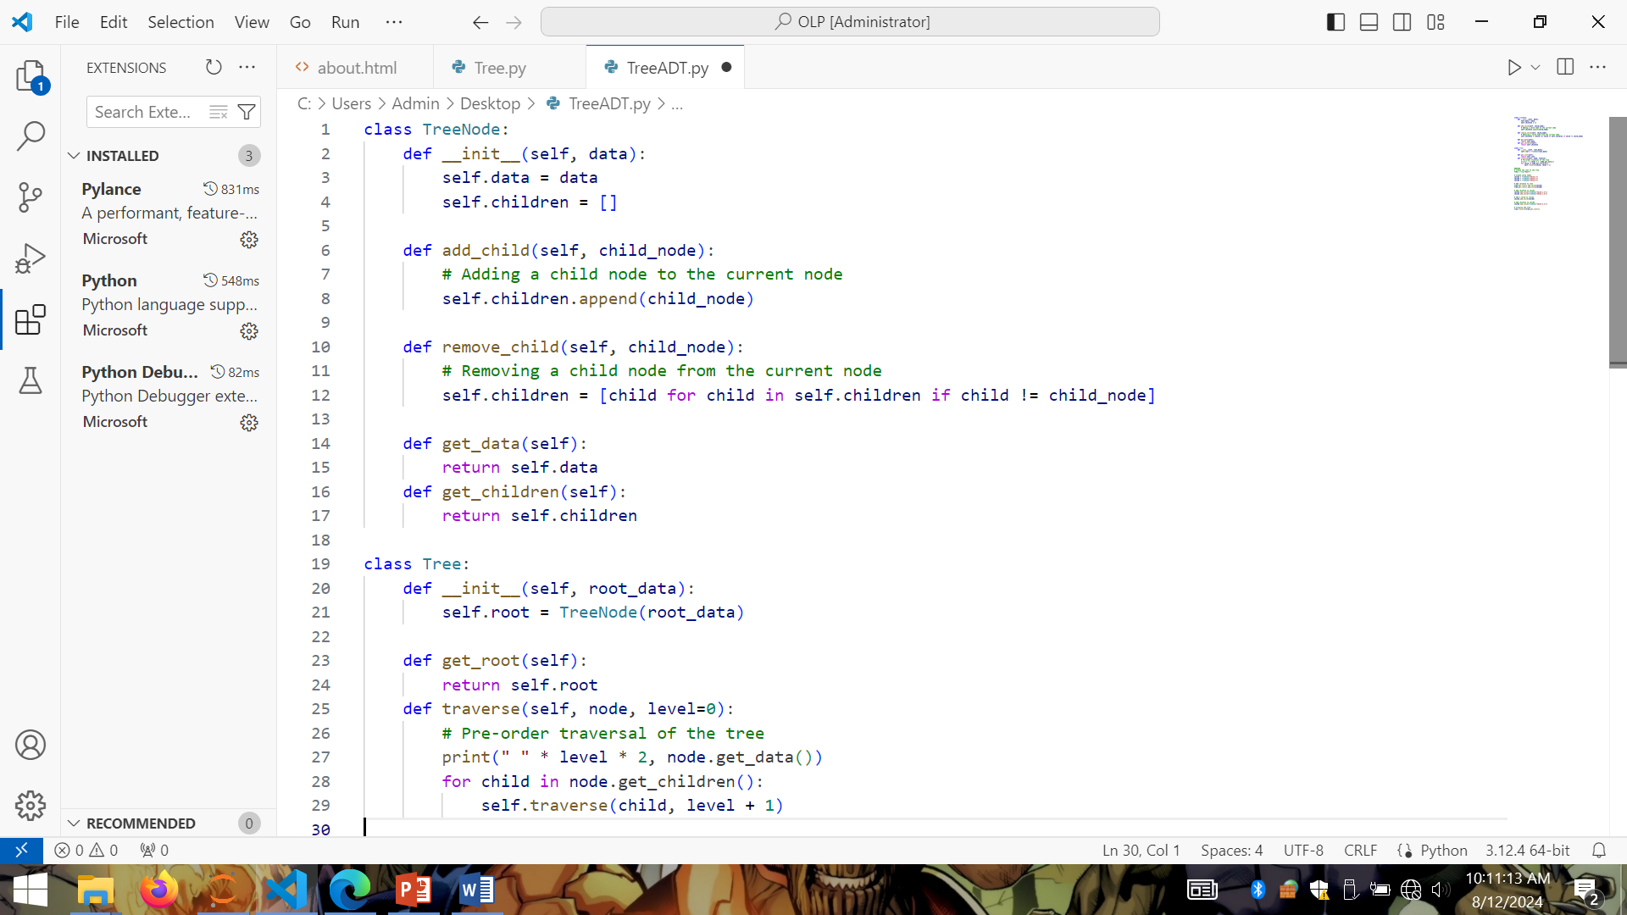
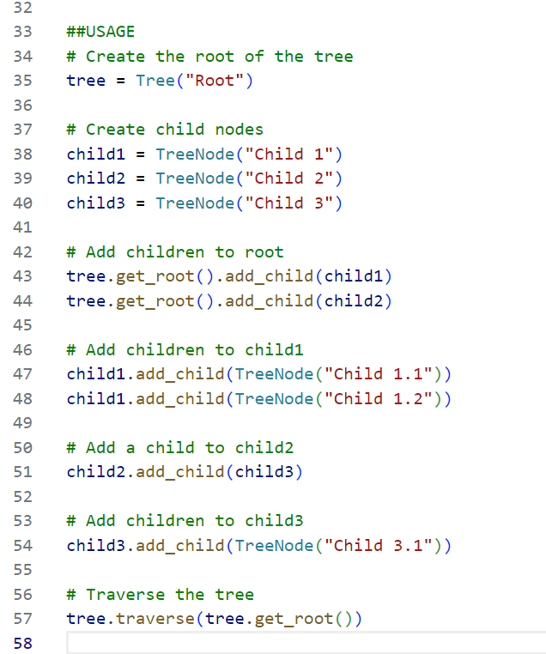
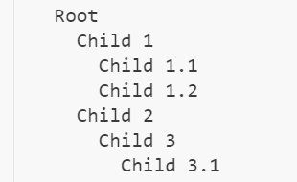
Implementation of Tree ADT in Python

Slide 10
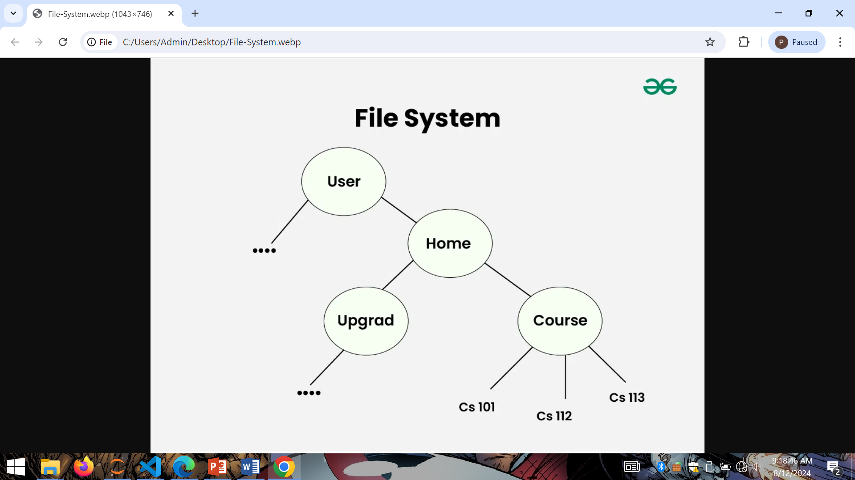
TREE ADT APPLICATION IN REAL WORLD
Searching for Key –Special type of tree known as Binary Search Tree or BST can be used to find key comparatively faster than other data structures like Array or Linked List.

Slide 11
Big O Notation on Trees ADT
MEMORY USAGE (Space Complexity)
The space complexity of a tree depends on the number of nodes and the storage requirements for each node.
Performance (Time Complexity)
Performance refers to the time complexity of common operations such as search, insertion, and deletion.
Complexity (General)
- Time Complexity: (O(n)), where (n) is the number of nodes. This is because every node needs to be visited exactly once.
- Space Complexity: (O(h)), where (h) is the height of the tree. The space is needed for the call stack during recursion, especially in the case of deep trees.

Slide 12
Advantages and Disadvantages of Trees Data Structure
Advantages
Tree offer Efficient Searching Depending on the type of tree, with average search times of O(log n) for balanced trees like AVL.
Trees provide a hierarchical representation of data, making it easy to organize and navigate large amounts of information.
The recursive nature of trees makes them easy to traverse and manipulate using recursive algorithms.
Disadvantages
Unbalanced Trees, meaning that the height of the tree is skewed towards one side, which can lead to inefficient search times.
Trees demand more memory space requirements than some other data structures like arrays and linked lists, especially if the tree is very large.
The implementation and manipulation of trees can be complex and require a good understanding of the algorithms.

Slide 13
Thank You For Listening
☺

